Slide 1



Amante, Grifaith
Camance, Paul Dwight
Dacaymat,Einstien
Meniano, Cyrus Jasper
Salvo, Feb Josh
Group of Dacaymat
Presentor

Slide 2

INTRODUCTION
Welcome to MIO, the all-in-one app that brings together events from the municipalities of Misamis Oriental. Whether you're a local or a visitor, MIO makes it easy to discover, explore, and enjoy a wide variety of events happening throughout the province. Our team has worked hard to create an app that’s both functional and user-friendly, ensuring a smooth experience every time you use it. With MIO, you can stay up to date on everything from cultural festivals and community events to concerts and sports activities, all through an intuitive design and seamless integrations. MIO isn’t just an event directory it’s a reflection of the lively and welcoming spirit of Misamis Oriental.

Slide 3
Objectives
Centralize Event Information
Promote Community Engagement
Provide Real-Time Updates
Support Cultural Tapestry of Misamis Oriental
Encourage Regional Tourism

Slide 4
Scope and Delimitation
SCOPE:
Event Coverage:
MIO will display events from municipalities in Misamis Oriental.
Target Audience:
The app is for both locals and visitors to easily access event information.
Real-time Updates:
Users will receive real-time updates on events, including changes and cancellations.
User Interaction:
MIO will allow users to browse, view event details and pin events.

Slide 5
Scope and Delimitation
DELIMITATION:
Geographical Limitation:
MIO will focus solely on events within Misamis Oriental.
Event Types:
Only public events organized by local municipalities will be featured.
Event Information:
Event details depend on data provided by local municipalities and organizers.
Language and Accessibility:
The primary languages will be Filipino and English, with other languages available based on organizer’s submissions.

Slide 6
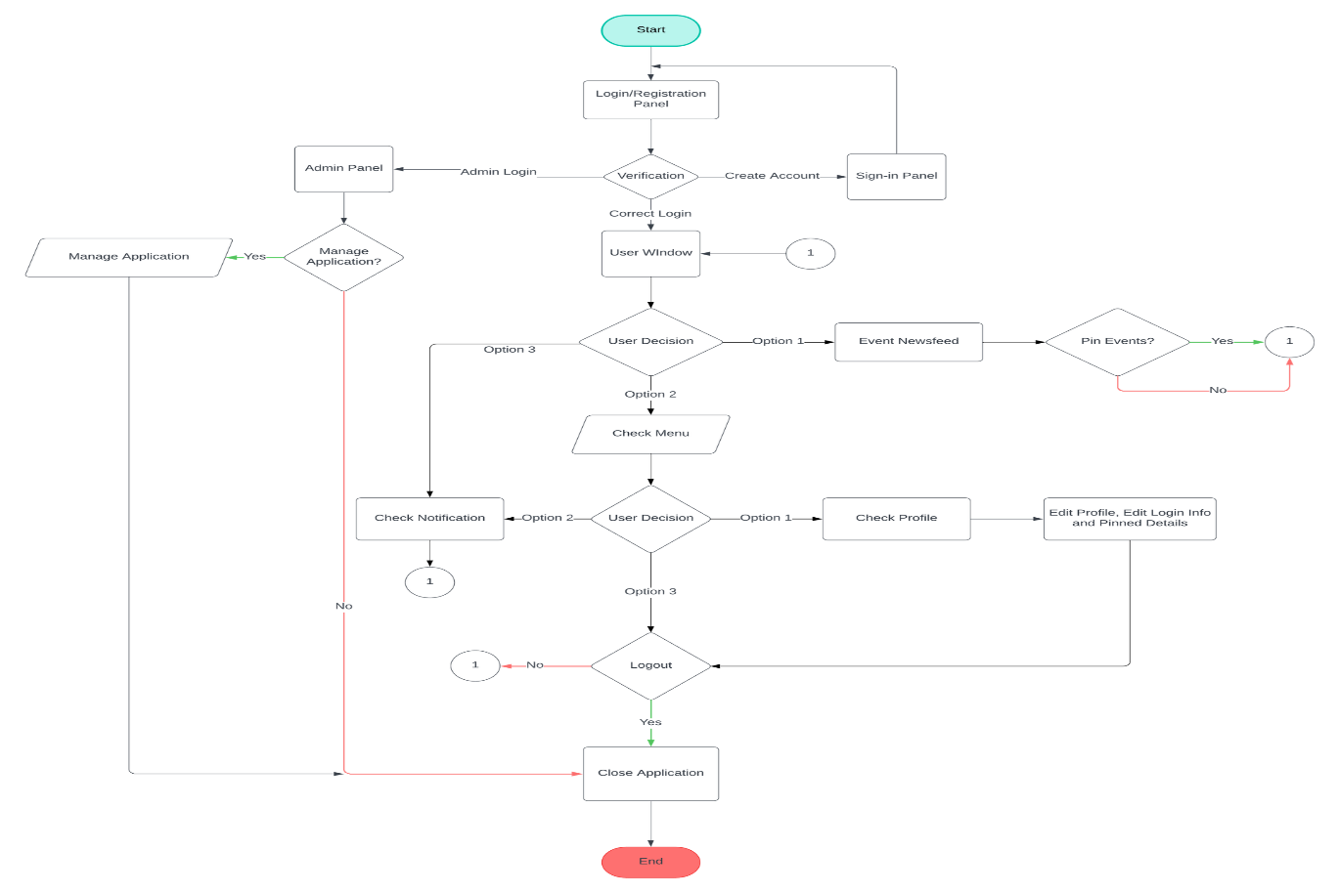
FLOWCHART

Slide 7
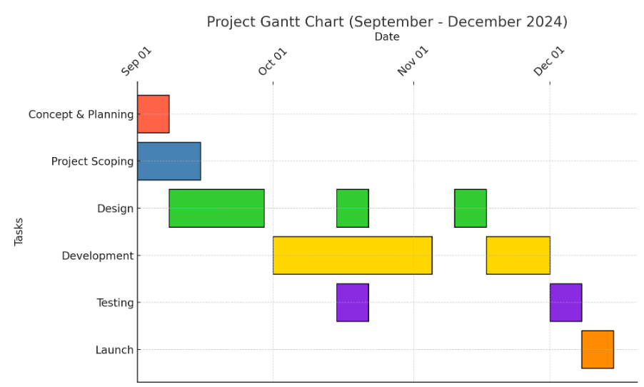
GANTT CHART

Slide 8
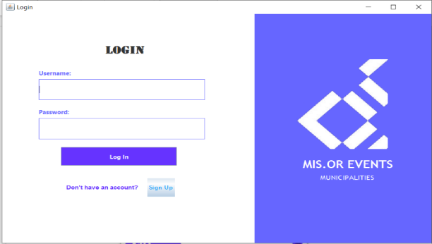
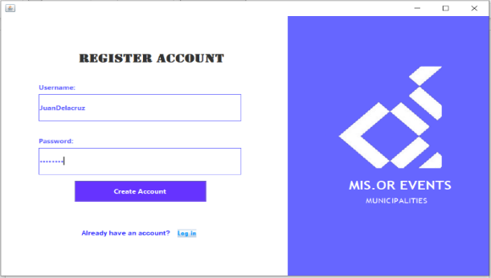
SYSTEM DESIGN
The system features a login and register interface as the main access point, providing fields for username and password, along with a "Log In" button and a sign-up option for new users. The design is minimalistic, incorporating the application's branding through a prominently displayed logo and name.

Slide 9
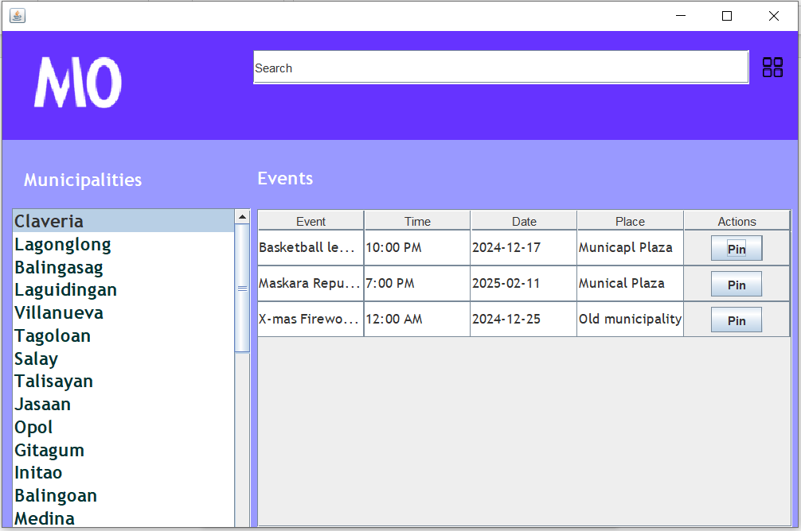
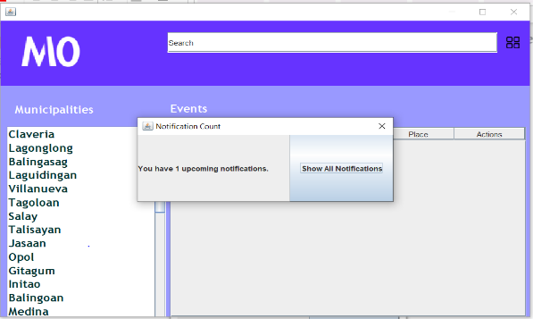
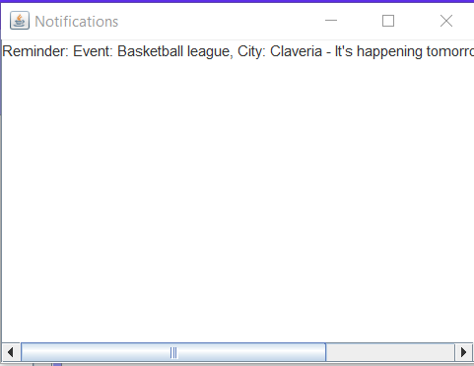
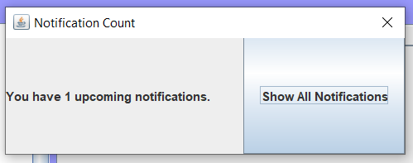
SYSTEM DESIGN
A notification will pop if there is an upcoming pinned event clicking the “Show All Notification” will show all pinned events notification. The events management interface enhances the user experience by allowing event exploration through a scrollable list of municipalities within Misamis Oriental. It includes a search bar for efficient retrieval of specific events and a well-structured table that displays event details such as name, time, date, location, and available actions, such as pinning or registration.

Slide 10
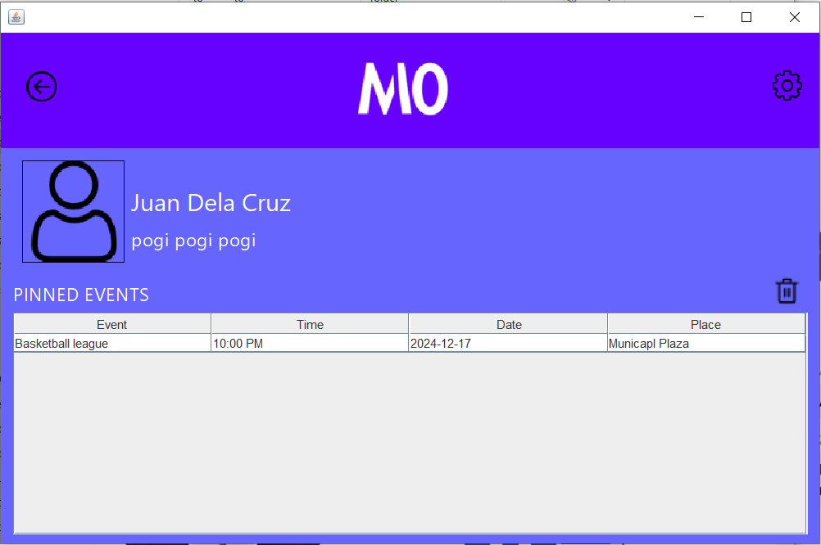
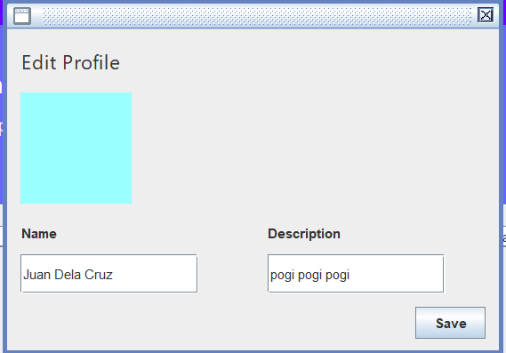
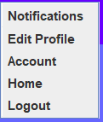
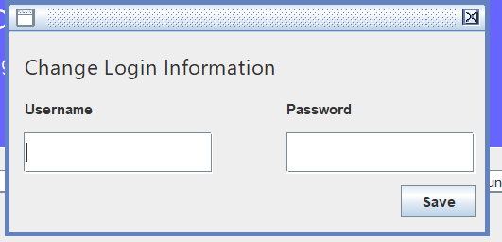
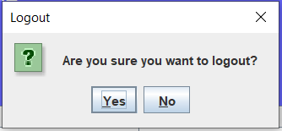
SYSTEM DESIGN
Users are directed to a personalized dashboard displaying their name and a table of pinned events with details like event name, time, date, location, and options for managing events, including deletion. A settings icon provides access to user configurations, such as editing the profile, account settings, notifications, and logout options. The application’s clean and intuitive design simplifies discovering, organizing, and participating in events tailored to user preferences.

Slide 11
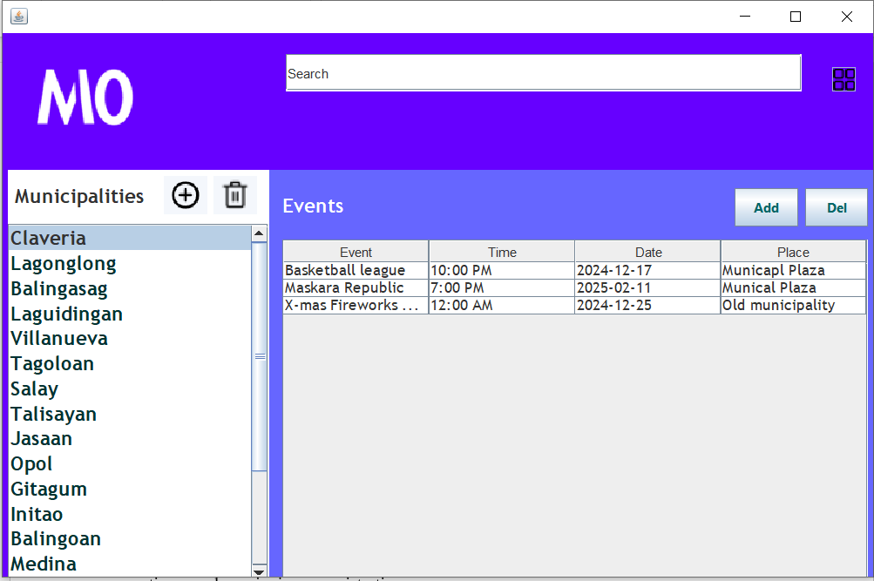
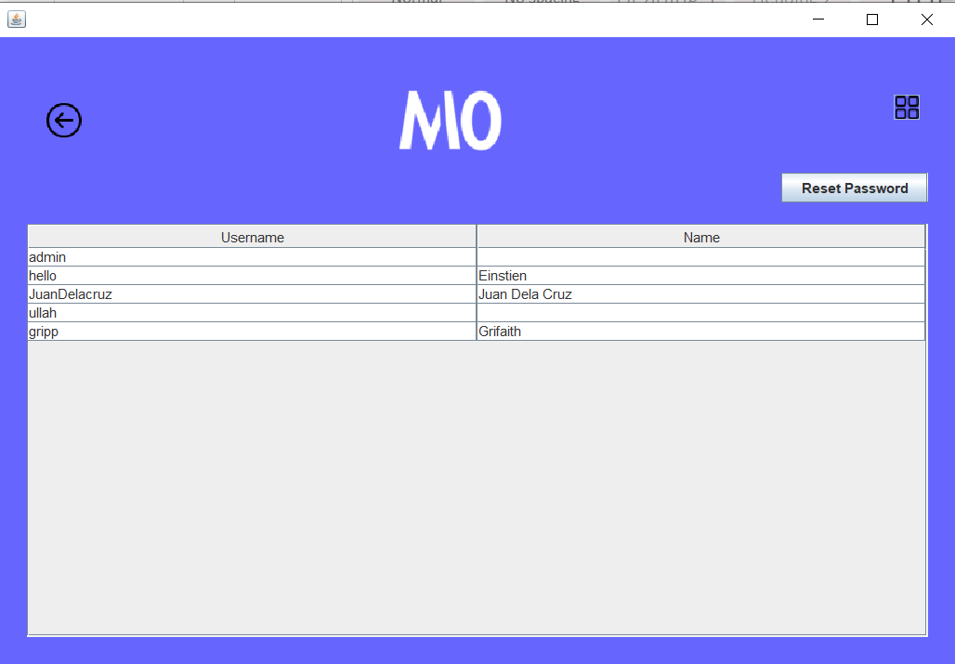
SYSTEM DESIGN
The admin dashboard for MIO is a comprehensive and user-friendly interface designed to efficiently manage events and municipalities. It offers robust event management capabilities, enabling administrators to effortlessly create, edit, and delete events while providing detailed information such as dates, locations, descriptions, and categories to ensure accuracy and consistency.
The admin side of MIO features a secure system for managing usernames and encrypted passwords, ensuring user data privacy. It uses a protected database with controlled access and logs all account changes, allowing administrators to reset passwords and update usernames efficiently while maintaining audit trails.

Slide 12
CONCLUSION
MIO is a platform dedicated to celebrating and sharing the cultural heritage of Misamis Oriental. It serves as a vital resource for both residents and visitors, offering easy access to a wide range of events, including cultural festivals, community gatherings, and local activities. With its user-friendly interface and robust features, MIO allows users to navigate and engage with events effortlessly. The platform helps locals stay connected with their community and provides visitors with the tools to explore and immerse themselves in the vibrant life of Misamis Oriental.

Slide 13
RECOMMENDATION
To enhance the functionality and accessibility of the municipal events application, it is recommended to develop a robust server infrastructure capable of supporting multiple users concurrently, ensuring seamless and efficient coordination across various departments. Expanding the scope of the application to encompass a broader range of services and activities will provide a comprehensive solution that effectively addresses the diverse needs of the community.

Slide 14
RECOMMENDATION
Additionally, the introduction of a mobile version will increase accessibility, allowing users to engage with the application conveniently and in real-time, regardless of their location. The integration of a calendar feature will further optimize event planning and management, enabling users to track, schedule, and receive timely updates on municipal events. These enhancements will significantly improve the application's utility and overall user experience.

